Slide 1
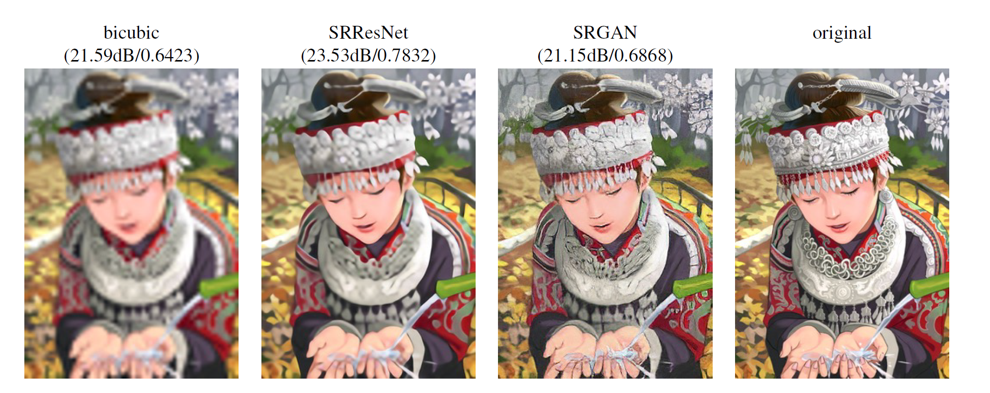
Super Resolution with SRGAN
GROUP 9
INSERT TITLE IMAGE HERE
Zhihao Xiong, Liang Ma
Hands-on Deep Learning

Slide 2
Task
Task
Producing a highresolution (HR) image from its low-resolution (LR) counterpart through SRGAN
Train the default SRGAN and SRGAN with pixel shuffling for 15 epochs. Plot the training progress and compare them.
Compare your models to the pre-trained model provided in the repository.

Slide 3
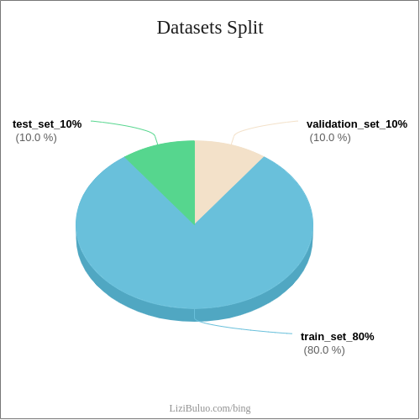
Datasets and Preprosessing
Datasets
Celeba
Totally 202599 images
Shrinkage of datasets
For training: 2000 images
For validation: 250 images
For testing: 250
Preprocessing
Original Images Size: 178*218
To LR Image: Size with 44*54 as Input
To HR Image: Size with 176*216

Slide 4
Default SRGAN
Generator
0-5 epochs
Interpolate
Tranposed Conv
5-10 epochs
Transposed
Tranposed Conv
10-15 epochs
VGG

Slide 5
SRGAN with Pixel Shuffle
SRResNet

Slide 6
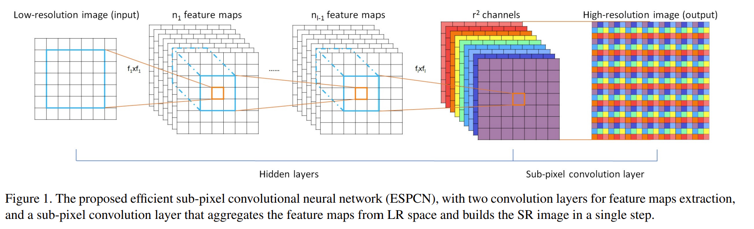
Pixel Shuffle
PixelShuffle is an operation used in super-resolution models to implement efficient sub-pixel convolutions with a stride of 1/r where r is an upscale factor . Specifically it rearranges elements in a tensor of shape (*,C x r^2, H, W) to a tensor of shape (*, C, H x r, W x r).

Slide 7
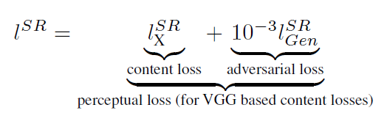
Training default SRGAN
Discriminator
BCE-Loss
- one for HR images
- one for Fake images
Generator
New Loss function with perceptual loss
- content loss: 0 - 10 epochs are MSE
loss between fake images and HR images;
10 - 15 epochs are VGG based Loss
- adversarial loss: The generative loss is defined based on the probabilities of the discriminator over all training samples as

Slide 8
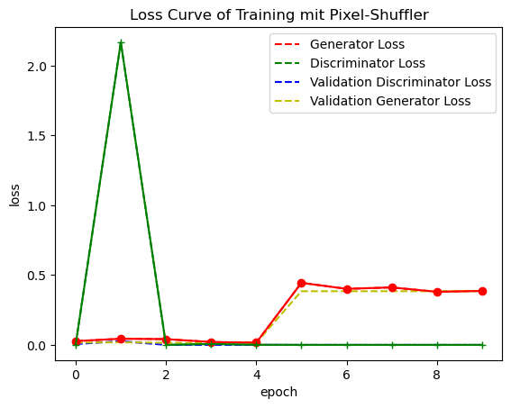
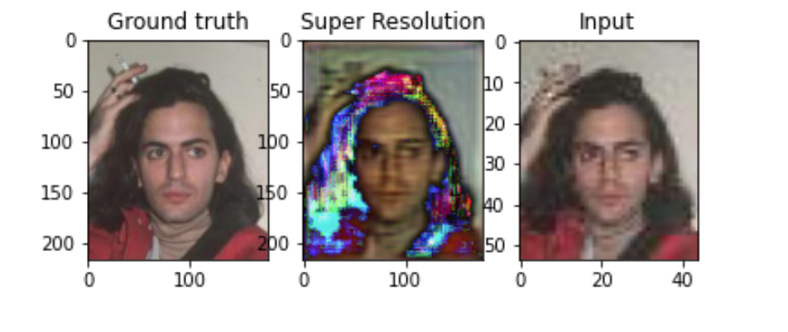
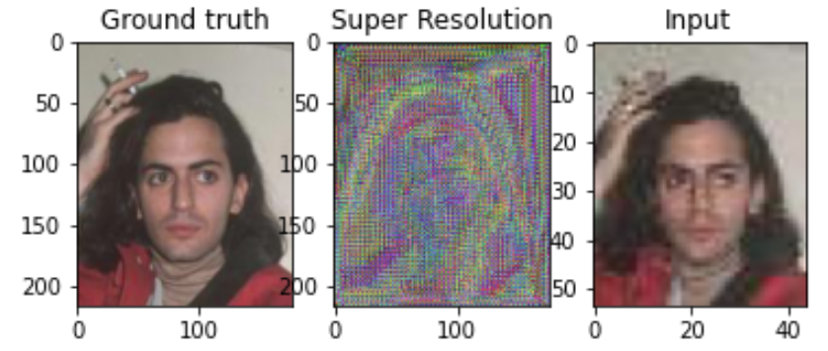
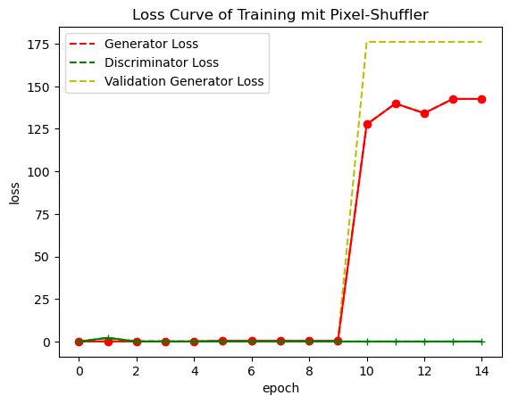
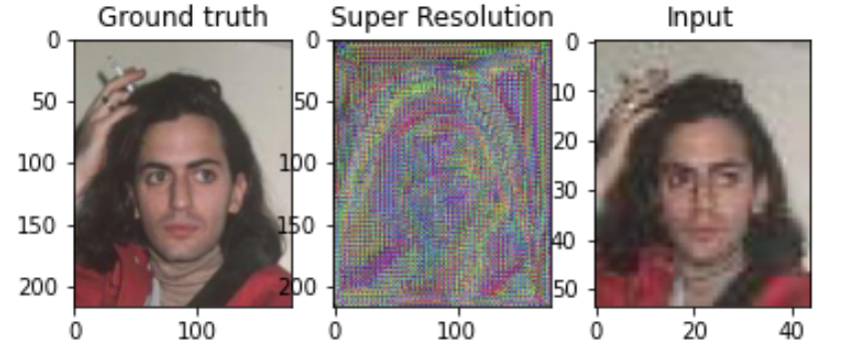
Traning default SRGAN

Slide 9
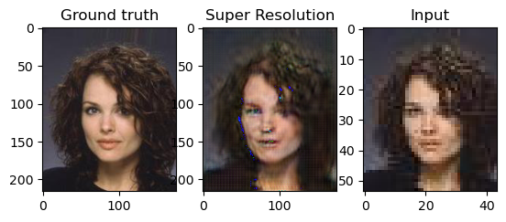
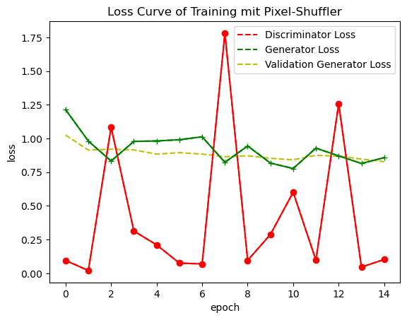
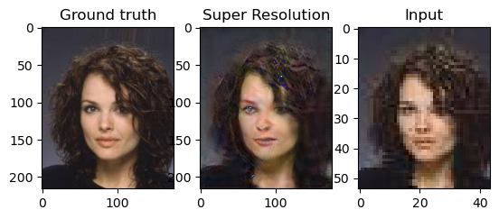

Traning SRGAN with Pixel Shuffle
0 epoch
15 epochs

Slide 10
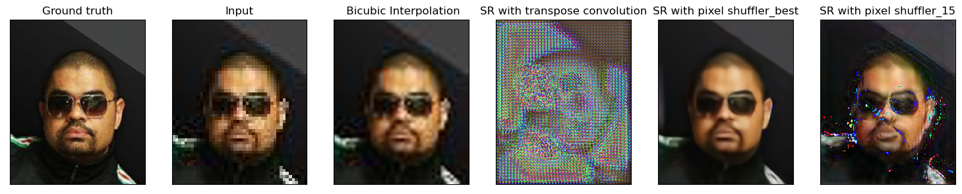
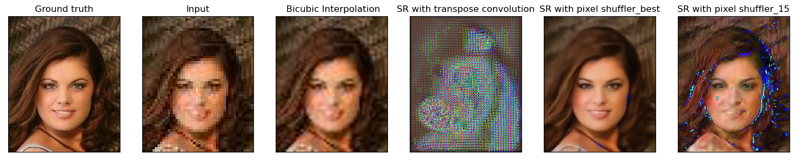
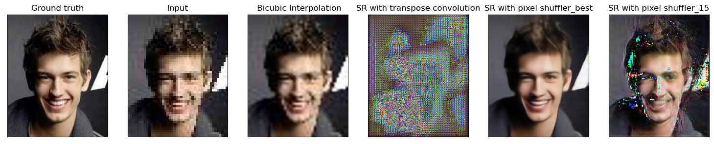
Results

Slide 11
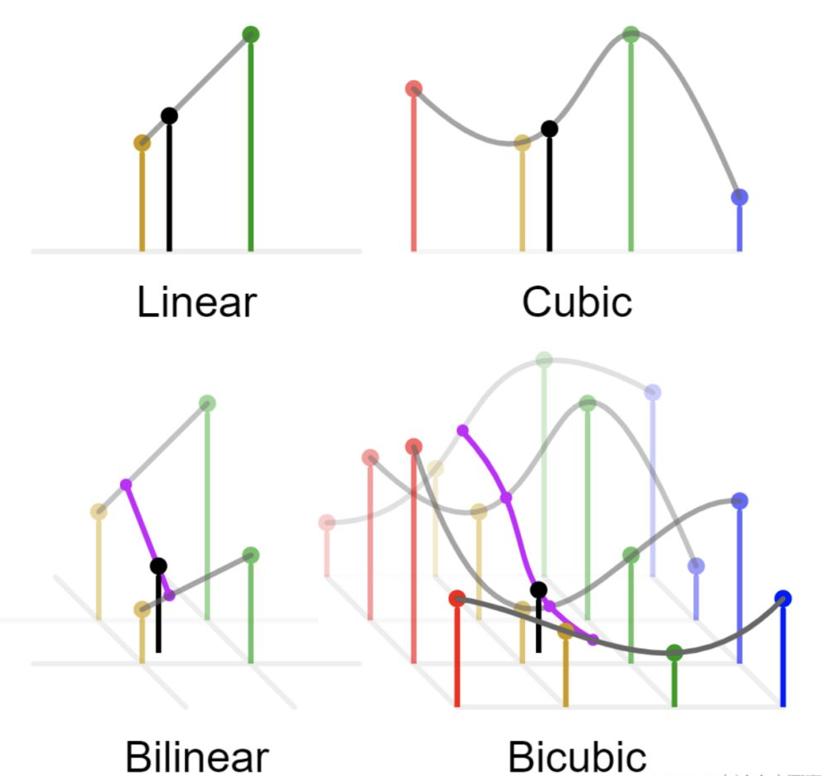

Slide 12
THANKS !

